Slide 2


Slide 3
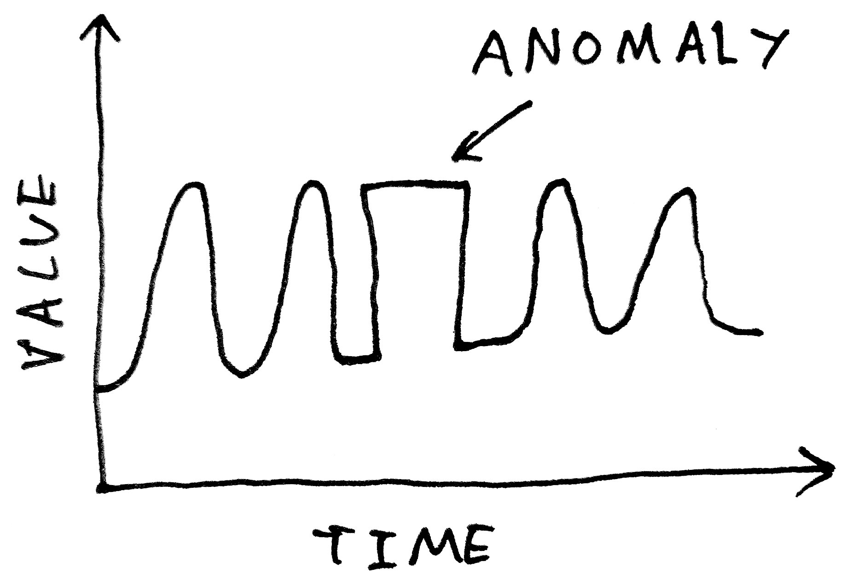
An introduction to Outlier Detection
Runar Helin
http://amid.fish/anomaly-detection-with-k-means-clustering

Slide 4

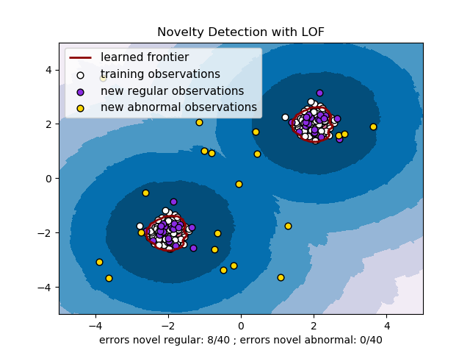
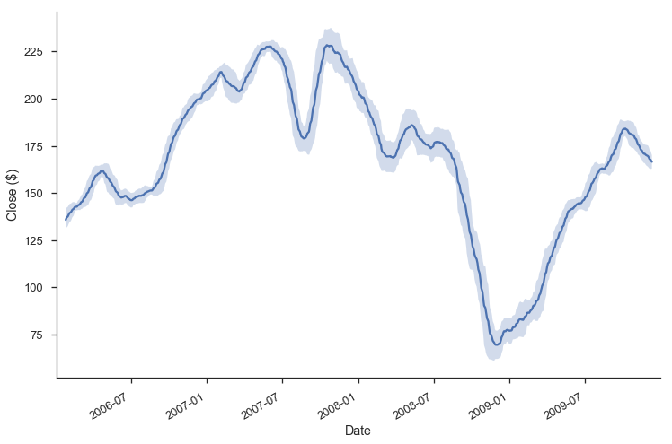
How can anomaly detection algorithms reveal new insight in our datasets?
[1]
[2]
[3]
Why we should care about
anomaly detection
Classical statistical
methods
Machine learning
based methods
[1]: https://pixabay.com/en/money-laundering-money-music-usa-462674/
[2]: https://tomaugspurger.github.io/modern-7-timeseries.html
[3]: http://scikit-learn.org/stable/auto_examples/neighbors/plot_lof_novelty_detection.html

Slide 5
How can anomaly detection algorithms reveal new insight in our datasets?
[1]
[2]
[3]
Why we should care about
anomaly detection
Classical statistical
methods
Machine learning
based methods
[1]: https://pixabay.com/en/money-laundering-money-music-usa-462674/
[2]: https://tomaugspurger.github.io/modern-7-timeseries.html
[3]: http://scikit-learn.org/stable/auto_examples/neighbors/plot_lof_novelty_detection.html

Slide 6
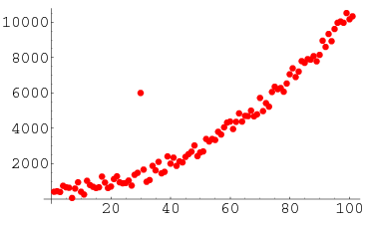
Anomaly (or outlier) detection is the art of discovering
datapoints that are unusual
http://mathworld.wolfram.com/Outlier.html

Slide 7



Why should we care?

Slide 8

Anomaly detection is an essential part of credit card fraud
detection
https://pixabay.com/en/hack-fraud-card-code-computer-3671982/

Slide 9

See the developer of Dawn of Titans talk about how they use anomaly detection to
catch cheaters here: https://www.youtube.com/watch?v=Q2HLPCBStLQ

Slide 10

Furthermore, it is used to find terrorists in national (and
international) surveillance databases
https://www.aclu.org/blog/national-security/secrecy/time-breaking-laws-injustice-nsa-surveillance

Slide 11


And many other things!!!
[1]
[2]
[1]: https://www.nasa.gov/jpl/multimedia/binary-stars-pia18463/
[2]: https://pixabay.com/illustrations/cyber-security-internet-hacking-3400555/

Slide 12
How can anomaly detection algorithms reveal new insight in our datasets?
[1]
[2]
[3]
Why we should care about
anomaly detection
Classical statistical
methods
Machine learning
based methods
[1]: https://pixabay.com/en/money-laundering-money-music-usa-462674/
[2]: https://tomaugspurger.github.io/modern-7-timeseries.html
[3]: http://scikit-learn.org/stable/auto_examples/neighbors/plot_lof_novelty_detection.html

Slide 13
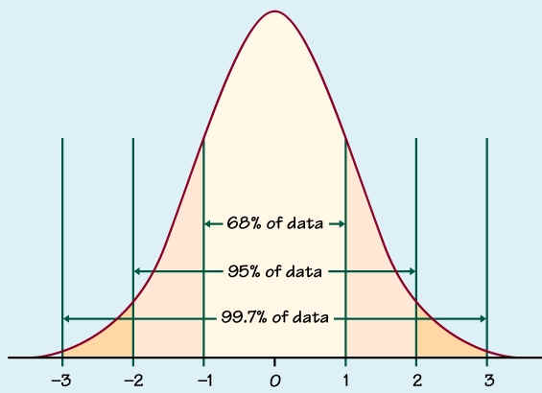
If the data is univariate, we might use a Z-score to detect
outliers
http://www.ltcconline.net/greenl/courses/201/probdist/zScore.htm

Slide 14
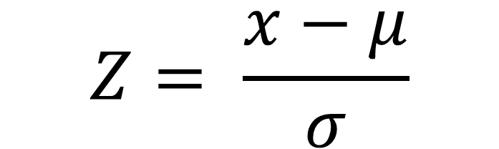
If the data is univariate, we might use a Z-score to detect
outliers
$$Z= \frac{x−μ}{σ}$$
http://www.ltcconline.net/greenl/courses/201/probdist/zScore.htm

Slide 15
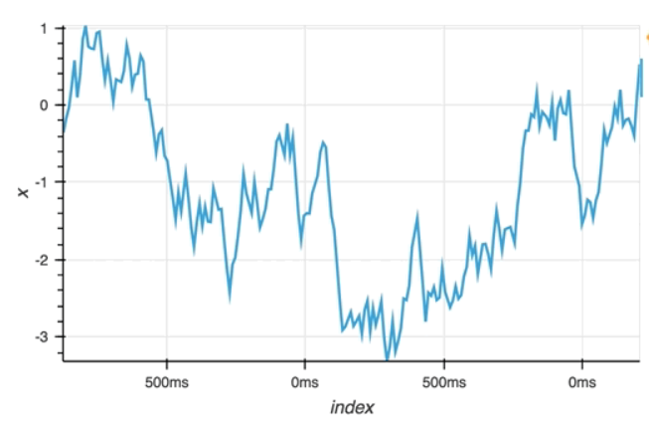
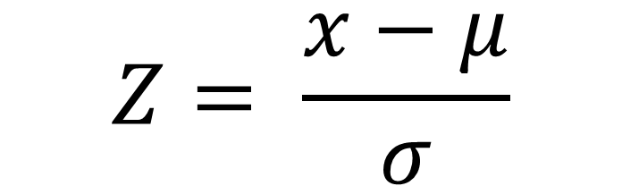
A benefit of this is that we can use it with a data stream,
only storing the most recent data points
$$Z= \frac{x−μ}{σ}$$

Slide 16
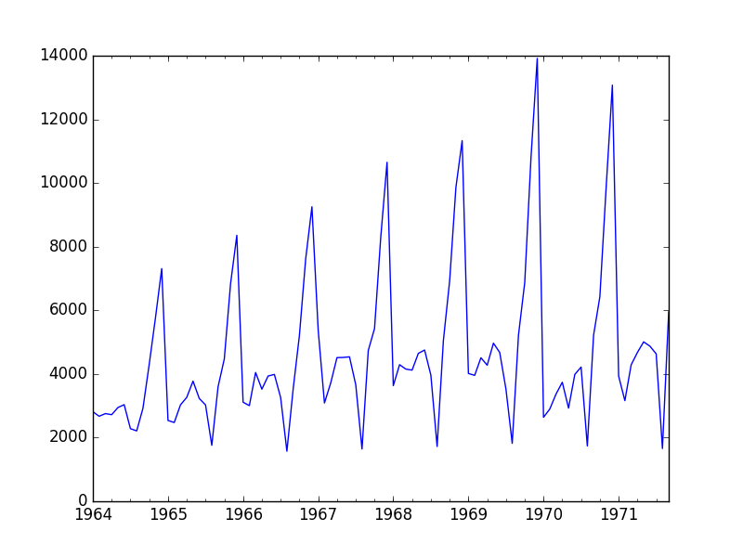
A downside, however, is that this will not work on data
with sudden seasonal shifts.
$$Z= \frac{x−μ}{σ}$$
https://machinelearningmastery.com/time-series-forecast-study-python-monthly-sales-french-champagne/

Slide 17
Furthermore, both the mean and standard deviation is
sensitive to outliers, thus, the occurance of several outliers
in one “window” will increase probability of false positives
$$Z= \frac{x−μ}{σ}$$

Slide 18
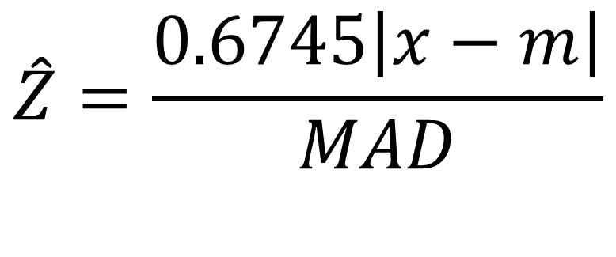
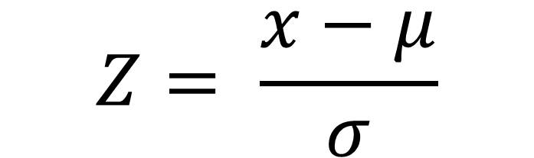
Therefore, we use a modifed Z score instead, which is a
robust estimator of the Z score
$$Z= \frac{x−μ}{σ}$$
$$\hat{Z}=\frac{0.6745\left|x−m\right|}{MAD}$$

Slide 19

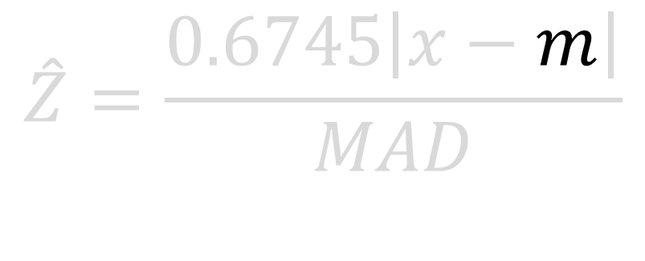
The modified Z score uses the median instead of the mean
$$median$$
$$\hat{Z}=\frac{0.6745\left|x−m\right|}{MAD}$$

Slide 20

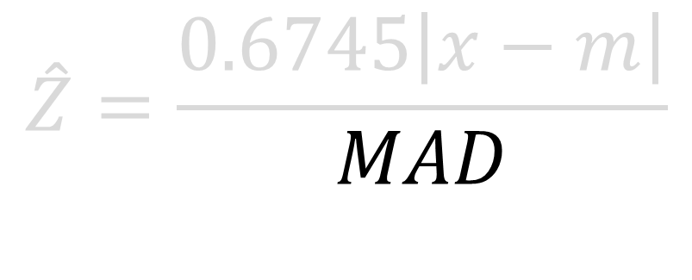

The modified Z score uses the median instead of the mean
$$median$$
$$\hat{Z}=\frac{0.6745\left|x−m\right|}{MAD}$$
$$median(\left|x_{i}−m\right|)$$

Slide 21
$$median$$
$$\hat{Z}=\frac{0.6745\left|x−m\right|}{MAD}$$

Slide 22

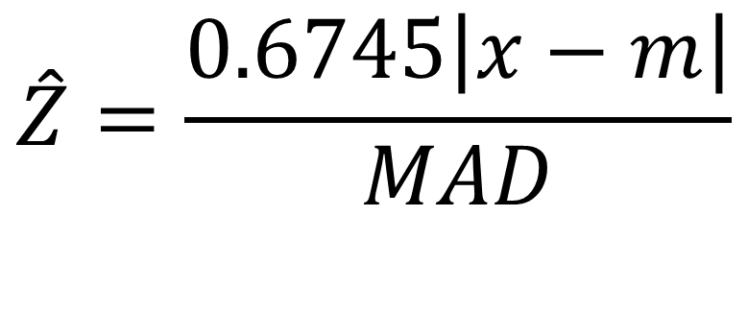
This might seem like a simple method, but it can be very
useful in the right system
$$\hat{Z}=\frac{0.6745\left|x−m\right|}{MAD}$$
https://predictabledesigns.com/introduction-to-microcontrollers/

Slide 23
Finally, we look at two multivariate methods for anomaly detection
[1]
[2]
[3]
Why we should care about
anomaly detection
Classical statistical
methods
Machine learning
based methods
[1]: https://pixabay.com/en/money-laundering-money-music-usa-462674/
[2]: https://tomaugspurger.github.io/modern-7-timeseries.html
[3]: http://scikit-learn.org/stable/auto_examples/neighbors/plot_lof_novelty_detection.html

Slide 24
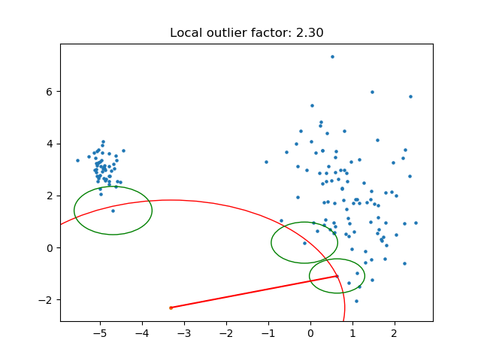
The first method we look at is the local outlier factor

Slide 25
The local outlier factor compares the data density for each
point with the density of their neighbouring points.

Slide 26

The other multivariate method for outlier detection that
we will discuss uses an ensemble of isolation trees
https://pixabay.com/photos/dawn-road-fog-landscape-trees-3208158/

Slide 27
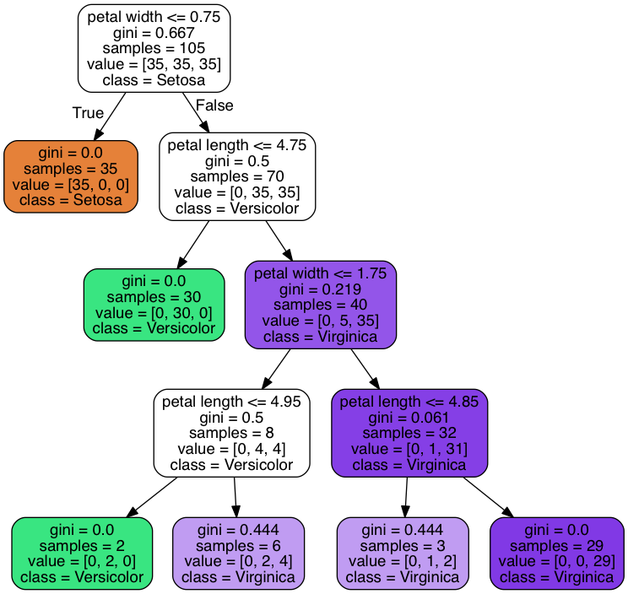
An isolation tree is a kind of decision tree

Slide 28
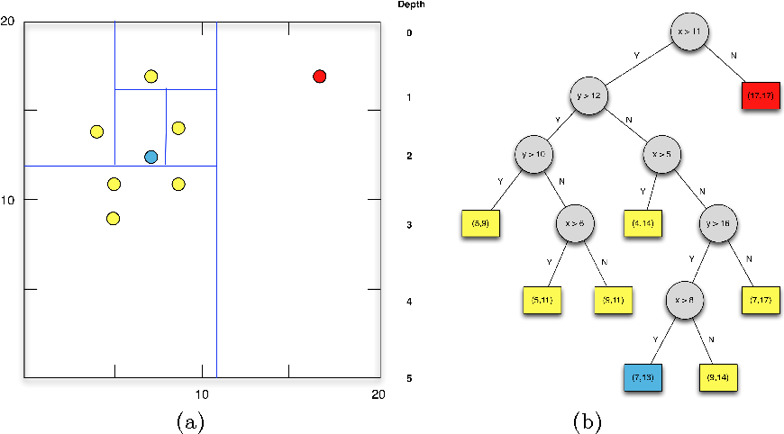
The threshold randomly drawn from values between the minimum and maximum value of the training
data arriving at the split
https://www.semanticscholar.org/paper/Detecting-Anomalous-User-Behavior-Using-an-Extended-Sun-Versteeg/3733449bbd4230c2cadf0166011ba4bcd3717a2a

Slide 29
The threshold randomly drawn from values between the minimum and maximum value of the training
data arriving at the split
https://www.semanticscholar.org/paper/Detecting-Anomalous-User-Behavior-Using-an-Extended-Sun-Versteeg/3733449bbd4230c2cadf0166011ba4bcd3717a2a

Slide 30
The decision tree algorithm continue to split until either:
Each leaf node contains only a single data point
Each leaf node contains unique values only
The tree reaches a pre-defined depth
https://www.semanticscholar.org/paper/Detecting-Anomalous-User-Behavior-Using-an-Extended-Sun-Versteeg/3733449bbd4230c2cadf0166011ba4bcd3717a2a

Slide 31
Outliers are more likely to be in an early leaf node, so we
use how quickly it is isolated to test for outliers

Slide 32
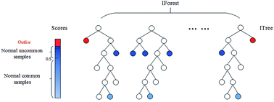
This does not work well for only one tree, which is why we
use an ensemble of them, naming the algorithm isolation
forest
https://pubs.rsc.org/en/content/articlelanding/2016/ay/c6ay01574c

Slide 33
Time to detect hackers!

